Slide 1
Introduction to Java Algorithm
Session 1
D6421 – Muhammad Fikri Hasani

Slide 2
Outline
Course outline
Introduction
Java Edition
Creating, Compiling, and Executing a Java Program
Control Structure
Arithmetic Operations
Math Class and Methods

Slide 3
Introduction to Java Algorithm
Introduction
Welcome abroad everyone in object-oriented programming course.
This course mainly talk about object oriented as one of the popular programming paradigm
This course will use Java programming language as programming language that only implement object-oriented programming as its paradigm.
For lecturers and Student, its strongly advised to read this powerpoint slides first and focused more on hands on while combining theory. Especially for the 1st Week session, where the topics are java programming language.
Don’t worry on the basic of Java Programming, because the basics of its syntax are mostly similar with C programming language.

Slide 4
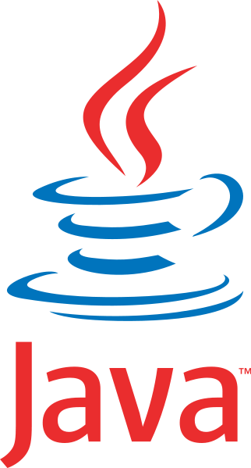
Introduction to java programming
introduction
Java was developed by a team led by James Gosling at Sun Microsystems
Originally called Oak (in 1991)
  Design for use in embedded chips in consumer appliance
Renamed Java (in 1995)
  Re-design for developing web based applications

Slide 5


Introduction to java programming
Java Edition and JRE
Java Edition:
  Java Standard Edition (Java SE): To develop client-side applications. Example: Creating JavaFX desktop app or console application.
  Java Enterprise Edition (Java EE): To develop server-side applications. Example: creating web app using Java Spring Boot
  Java Micro Edition (Java ME): To develop applications for mobile devices and embedded devices.
Java Runtime Environment (JRE)
  A Software that execute Java based application
  Java Virtual Machine (JVM) is a collection of programs to execute java bytecode on any computer platform.

Slide 6



Introduction to java programming
Java development kit (JDK) and IDE
Java Development Toolkit (JDK) consist of set of separate program, each invoked from a command line, for developing and testing Java programs. There are several company that provide their own version of JDK, such as Oracle, Azul Zulu, IBM, Redhat, Microsoft
Java development tool is a software that provides an Integrated Development Environment (IDE) for rapidly developing Java programs.
Example of the most popular ones:
  Netbeans: (https://netbeans.apache.org/front/main/)
  IntelliJ IDEA: (https://www.jetbrains.com/idea/)
  Eclipse: (https://www.eclipse.org/downloads/packages/release/kepler/sr1/eclipse-ide-java-developers)

Slide 7
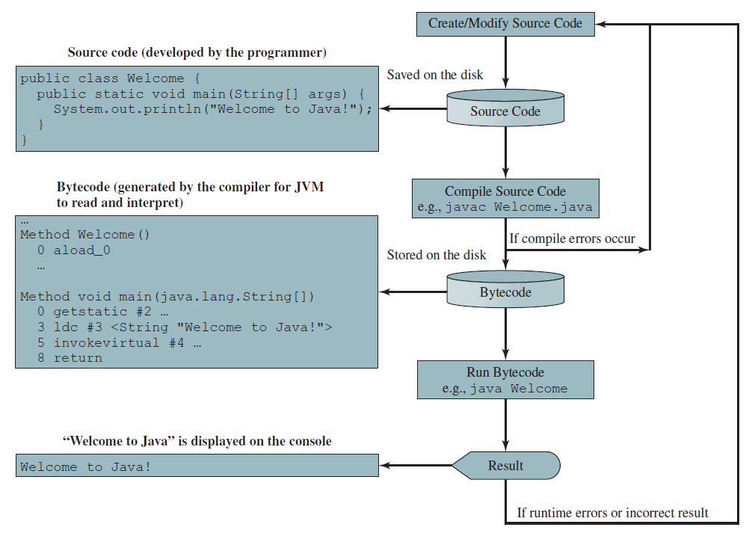
Introduction to java programming
Steps of java program

Slide 8
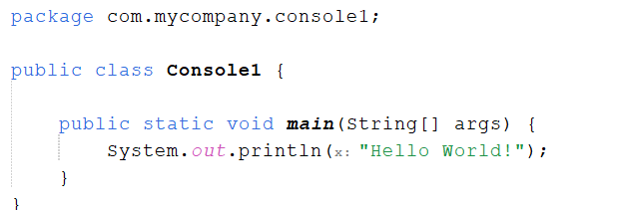
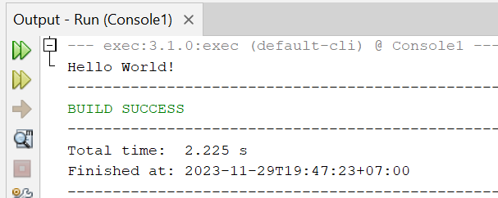








Introduction to java programming
Simple java program
Package name
Class name
Access Modifier
Block Statement
Program when running using NetBeans IDE (internal console)

Slide 9
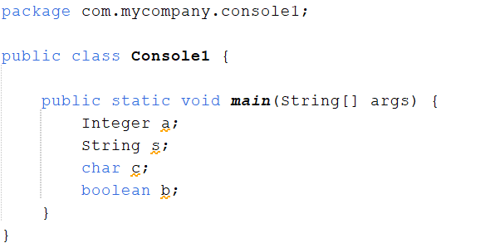





Introduction to java programming
identifier
an identifier is a name given to a variable, class, method, or other element.
It's a way to refer to that element in your code, and it's unique within the scope of your program.
Rules for identifiers:
  An identifier is a sequence of characters that consists of letters, digits, underscores (_), and dollar signs ($)
  An identifier must start with a letter, an underscore (_), or a dollar sign ($). It cannot start with a digit.
  An identifier cannot be a reserved word. See Appendix A for a list of reserved words. Reserved words have specific meaning in the Java language. Keywords are reserved words.
  An identifier can be of any length.
The circled words are identifiers

Slide 10


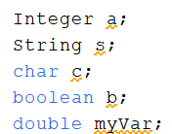



Introduction to Java Programming
Variables and Constant
variables are used to store values to be used later in a program.
They are called variables because their values can be changed.
Each variable also have data types
Examples:
Assigning value to variable:
Constant are variable that value cannot be changed. To declare a constant, simply add word “final”. Example:
If we try to change constant value, IDE will give error

Slide 11
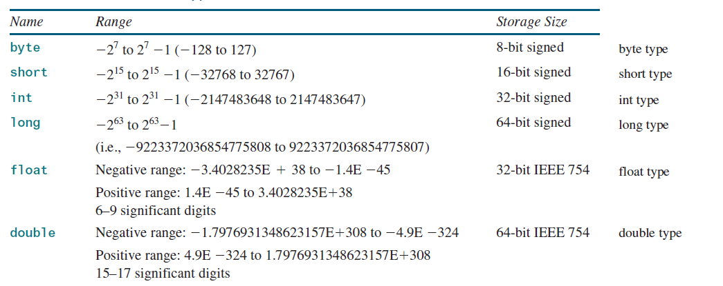
Introduction to Java Programming
Numerical Data types
Numerical data types are data types that hold numerical values.
It support any numerical operations such as +, - , / , * , decrement ( -- or -=) and increment (++ or += ).

Slide 12


Introduction to Java Programming
Character data type
The character data type, char, is used to represent a single character.
The increment and decrement operators can also be used on char variables to get the next or preceding Unicode character. For example, the following statements display character b

Slide 13

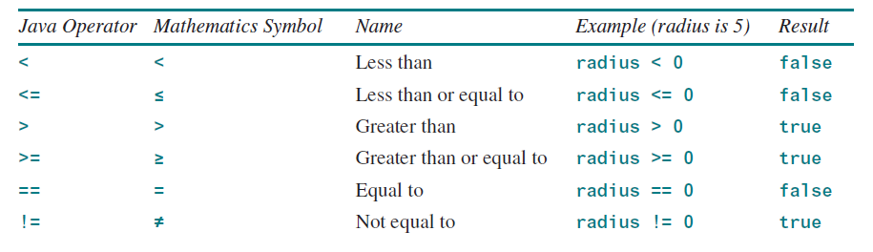
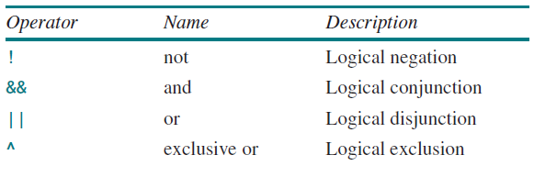
Introduction to Java Programming
Boolean Data types
Boolean is data type that can hold true or false.
Mainy used for logical operations and store value from relational or logical operation. It used boolean data type. Example:
Relational Operation
Logical Operation

Slide 14

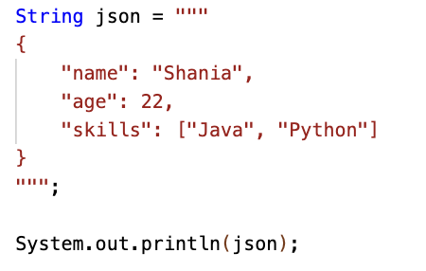
Introduction to Java Programming
String Data type and Class
The char type represents only one character. To represent a string of characters, use the data type called String.
String is a predefined class in the Java library, just like the classes System and Scanner.
The String type is not a primitive type. It is known as a reference type. Any Java class can be used as a reference type for a variable.

Slide 15
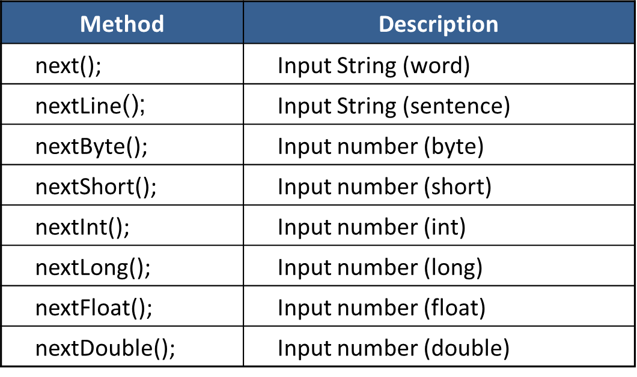
Introduction to Java Programming
Input
To perform console input, you need to use the Scanner class to create an object to read input from System.in,
Commonly used Scanner method:

Slide 16
Introduction to Java Programming
Output
System.out.println(parameter) → print into console with linefeed (newline)
System.out.print(parameter) → print into console without linefeed (newline).
System.out.printf(parameter) → same as System.out.print, supports format output. Format used the same as C printf() method.

Slide 17

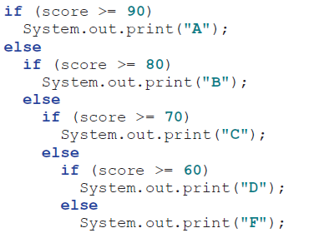
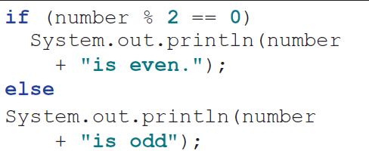
Introduction to Java programming
Control structure
Java have similar control structure with C, C++ or C#, mainly IF statement and Switch Statement
IF Statements:

Slide 18
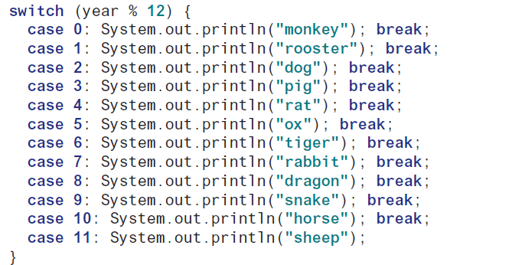
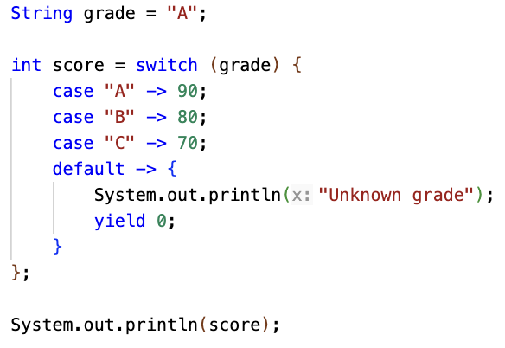
Introduction to Java programming
Control structure
Switch Statements:
Another example of Switch Statement:

Slide 19
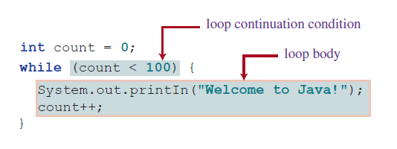
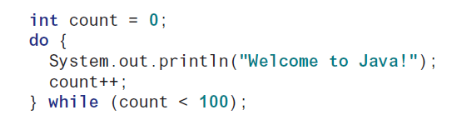

Introduction to java programming
Control structure
Java also support repetition control structure, which used to repeat block of code multiple times.
It support while loop, do while loop, and for loop, and also its nested variant.
It also support Jump operations such as break and continue, which are the same as in C.
While Loop
Do while loop
For loop

Slide 20
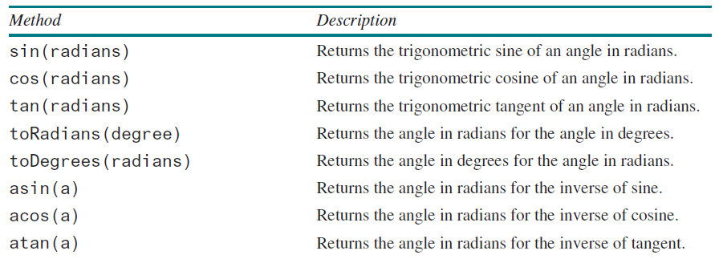
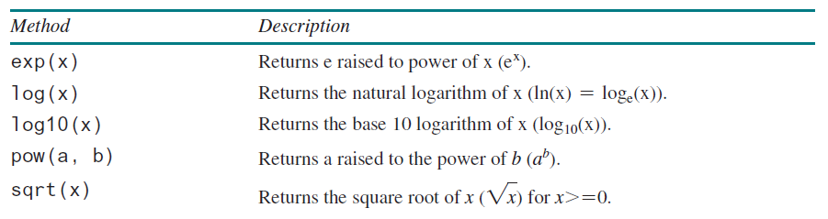
Introduction to Java Programming
Math functions
Java provides many useful methods in the Math lass for performing common mathematical functions.
Trigonometric function
Exponent functions

Slide 21
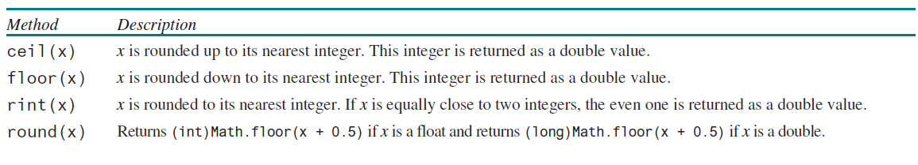
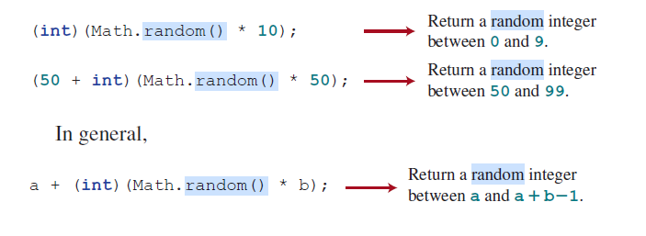
Introduction to Java programming
Math functions
Rounding values
Generate Random values

Slide 22

Introduction to Java programming
Runtime error
Runtime errors are errors that cause a program to terminate abnormally. They occur while a program is running if the environment detects an operation that is impossible to carry out.
Example:

Slide 23
Introduction to Java programming
Exception handling
Runtime errors:
  Occur while a program is running if the environment detects an operations that is impossible to carry out.
  Caused by exceptions.
Exception:
  An object that represent an error or a condition that prevents execution from proceeding normally.
If the exception is not handled, the program will terminate abnormally.

Slide 24
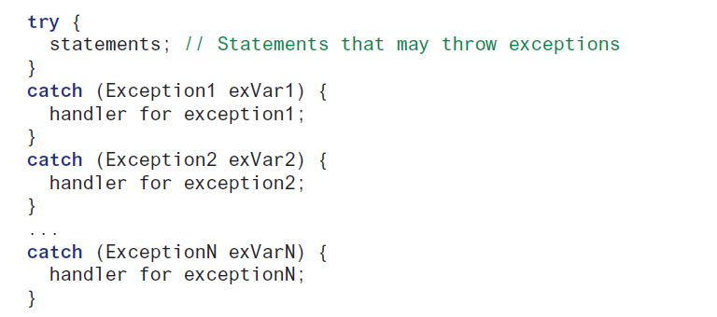
Introduction to java programming
Exception handling
Handling runtime errors (exception handling)
Using try and catch
If error not handled / catch, than error will continued to the next handling
Error not handled will cause program terminated.

Slide 25
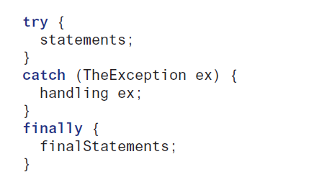
Introduction to java programming
Exception handling
Occasionally, you may want some code to be executed regardless of whether an exception occurs or is caught.
Java has a finally clause that can be used to accomplish this objective.
The syntax for the finally clause might look like this

Slide 26
exercise
BMI Calculator Program
Create a Java program that calculates the Body Mass Index (BMI) with the following requirements:
The program asks the user to input:
  Weight (kg)
  Height (cm)
Use a try-catch block to handle cases where the user enters non-numeric values. If an invalid input is entered, show an error message and ask again.
Convert the height from centimeters to meters.
Use arithmetic operations to compute BMI:
BMI = weight/(height_meter×height_meter)
Use a control structure (if-else) to determine the BMI category:
  BMI < 18.5: “Underweight”
  18.5 – 24.9: “Normal”
  25 – 29.9: “Overweight”
  BMI ≥ 30: “Obese”
Display the calculated BMI and its category.

Slide 27
Introduction to java programming
references
Daniel Liang, Introduction to Java Programming and Data Structure, 13th edition.

